Slide 1
Digital Contrast for Computerised Tomography
- Towards Climate Neutral and Sustainable Health Systems -

Slide 2
Towards NetZero Healthcare
Mitigating the environmental impact of radiology
with novel AI imaging solutions
Regent Lee Associate Professor, University of Oxford
Honorary Consultant Vascular Surgeon
UKRI Future Leaders Fellow
Scientific Coordinator – NetZeroAICT Consortium
Disclosure: R Lee is the Co-Founder and Chief Medical Officer of AiSentia
Photo credit: Jill Sauve

Slide 3
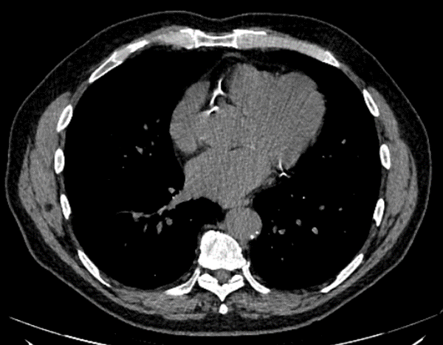
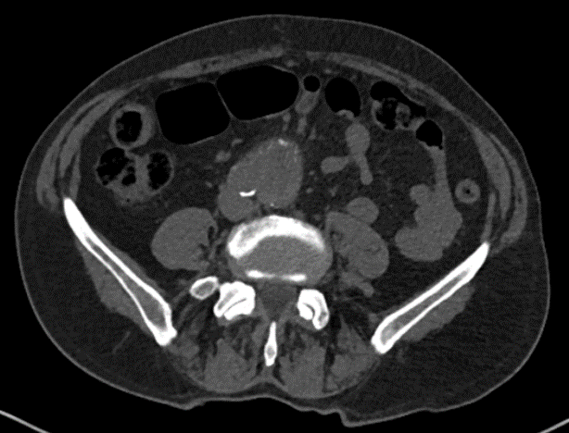
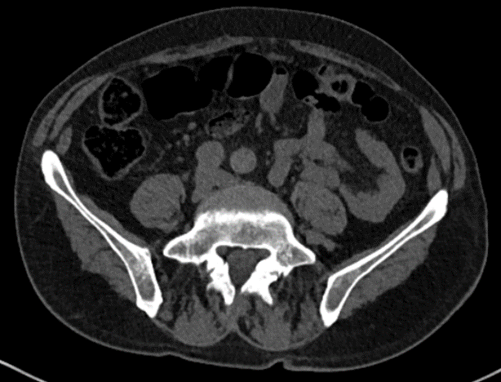
> 300 million CT scans are performed globally / year
No Contrast injection
No Contrast injection
No Contrast injection
Aorta
Iliac arteries
Muscle
Muscle
Bowel
Bowel
Chest
Abdomen
Pelvis
A non-contrast CT contains much information that human eyes can’t see.
~60% of CT scans have intravenous iodinated radiocontrast media (RCM)
injection to obtain Contrast-Enhanced CT scans

Slide 4
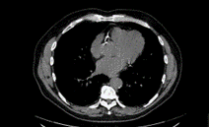
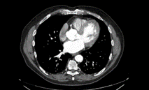
Conventional Patient Journey for a Contrast Enhanced CT
Needle
IV line
1st scan
no injection
Non-Contrast
CT
2nd scan
contrast injection
Contrast
CT
Timed

Slide 5
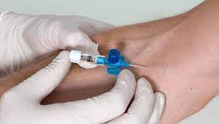
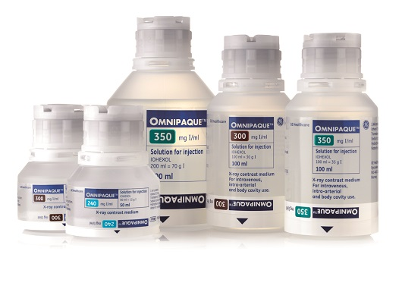
Problems associated with the intravenous injection of contrast agent
Needle (‘Drip’) insertion-related complications:
Pain and discomfort
Bleeding, haematoma
Contrast leakage out of the drip: skin necrosis
Injury of the nearby artery: pseudoaneurysm, ischaemia
Contrast related complications:
Contrast allergy / anaphylactoid reactions
Kidney toxicity:
Contrast-induced nephropathy
renal failure requiring dialysis/death (rare but devastating)
Cost of service provision:
Contrast agent, longer scan, management of complications
Lack of supply chain resilience

Slide 6
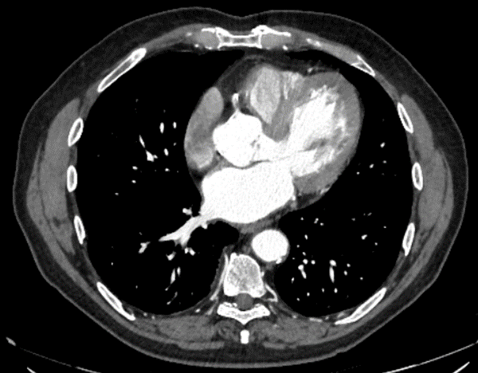
What if we could generate contrast enhanced CT images
without the need to inject intravenous contrast?

Slide 8
(University Oxford Spinout)

Slide 9
Conventional Patient Journey for a Contrast Enhanced CT
Needle
IV line
1st scan
no injection
Non-Contrast
CT
2nd scan
contrast injection
Contrast
CT
Timed
Patient Journey for a ‘CT Digital Contrast’
No
needle
One scan
no injection
Non-Contrast
CT
Artificial
Intelligence
Digital Contrast
CT

Slide 12
AICT Consortium Inaugural Members

Slide 14
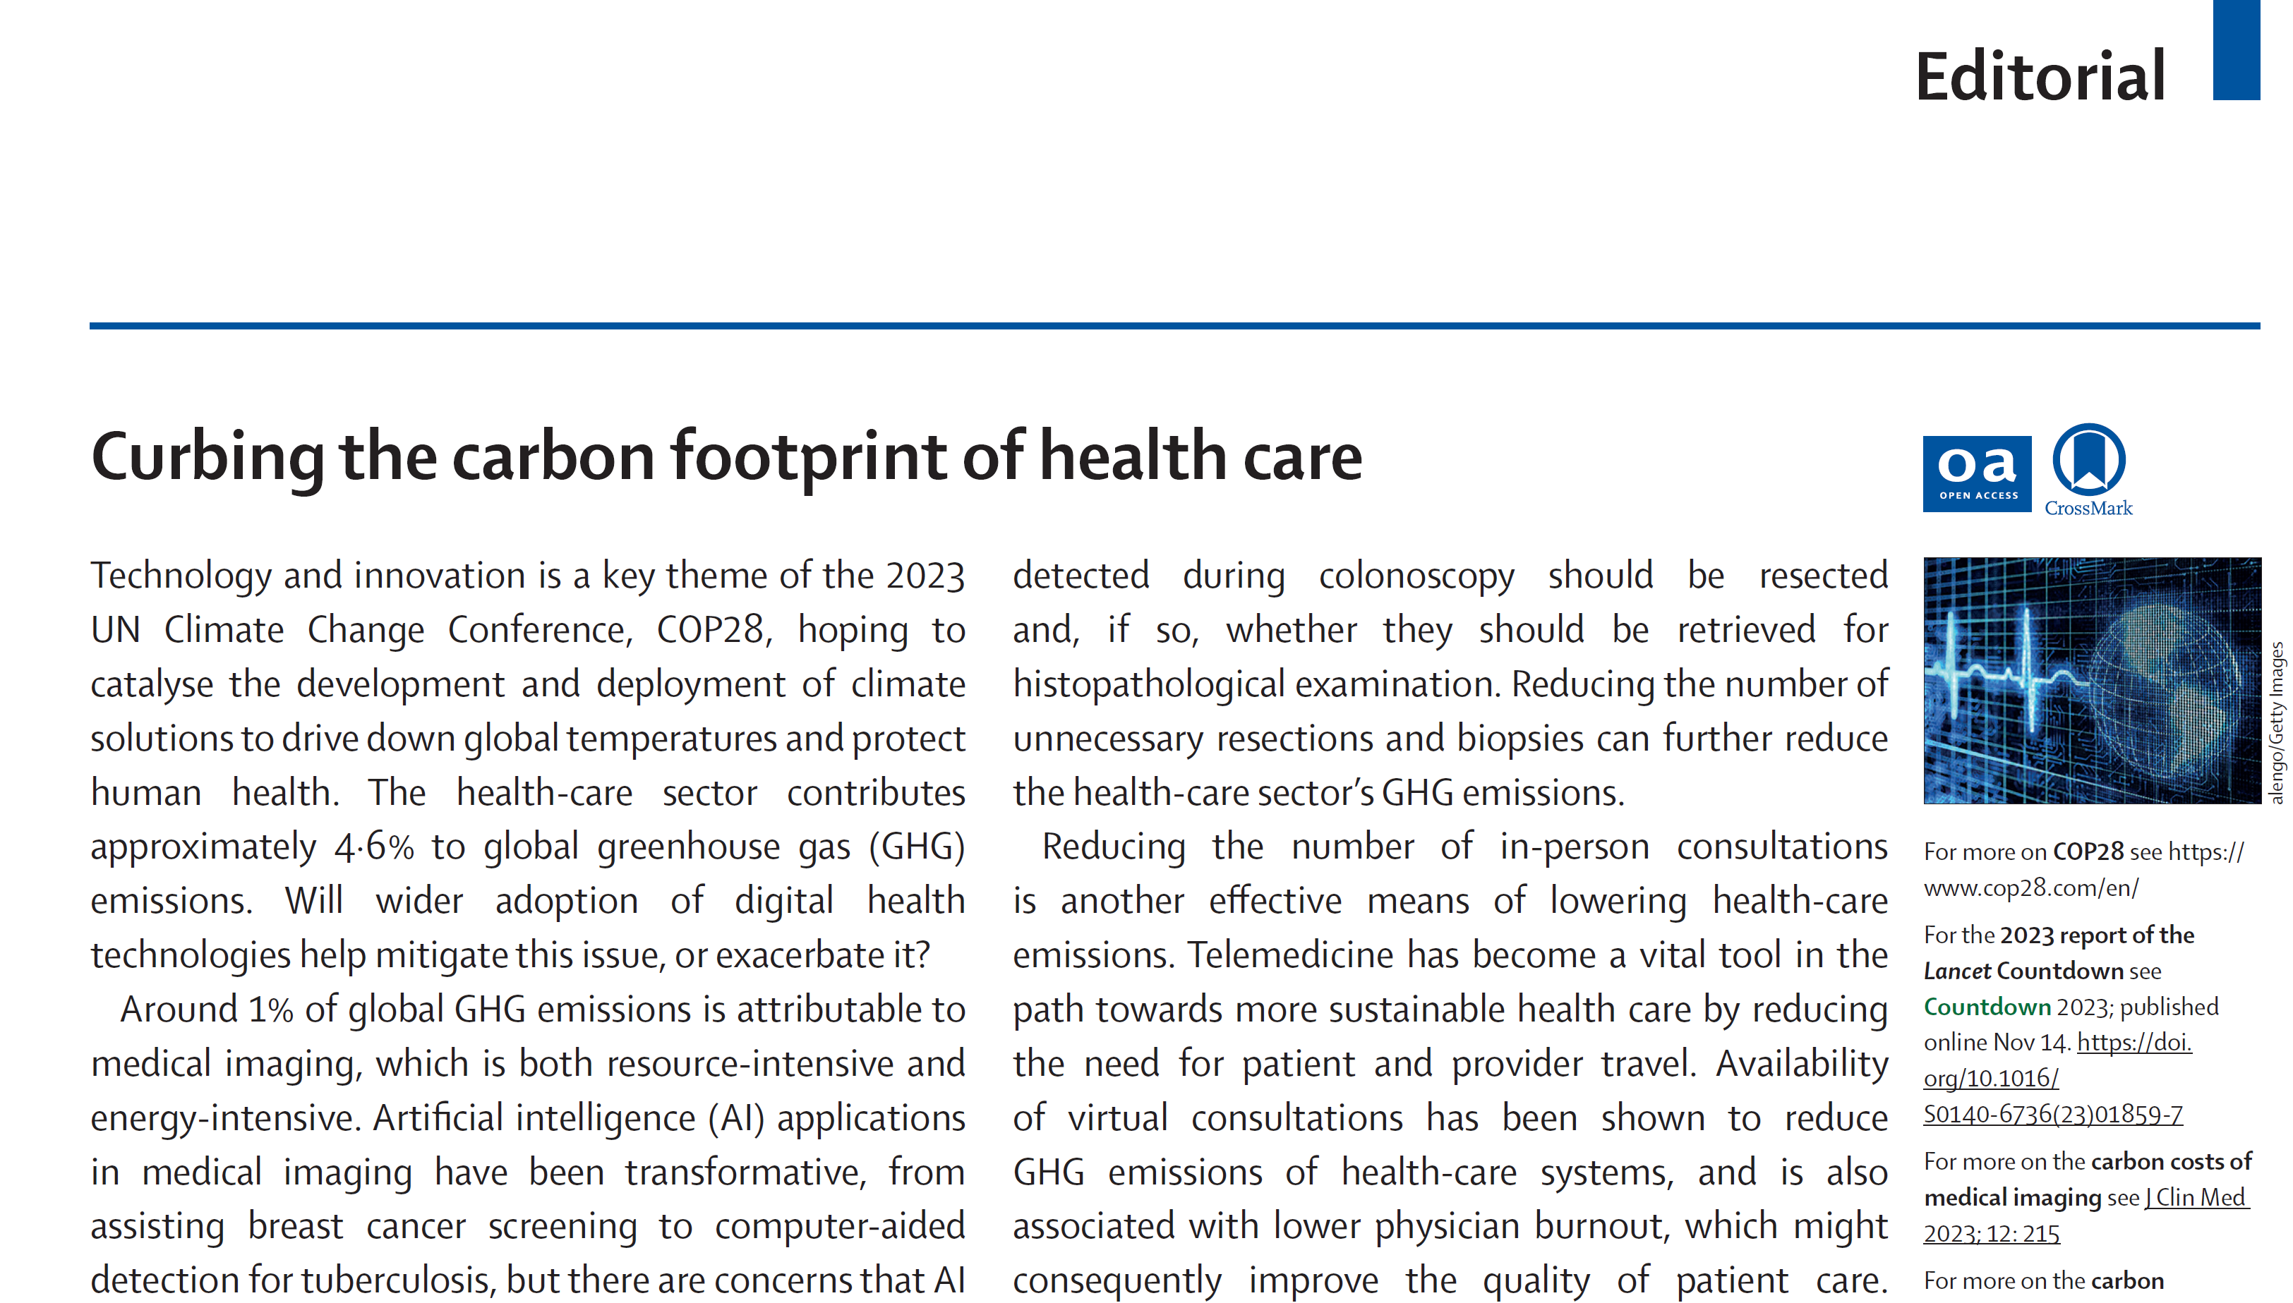

Slide 15
Contrast CT and environmental impact
Over 180 million contrast CT scans performed globally per year
generating combined sizable carbon footprints
Single use
packaging
Needle
(steel)
Plastic
waste
Energy
consumption
Iodine
in wastewater
42,000
tons
900
tons
90,000
tons
150,000,000
kWh
200,000
tons
Average CO₂ emission per CT scan is 9.2kg*!
*Source: Lancet Regional Health July 2022

Slide 16
Digital Contrast - Towards Sustainable and Climate Neutral Health Systems
With a target of reducing 30% of contrast CT scans
Single use
packaging
Needle
(steel)
Plastic
waste
Energy
consumption
Iodine
in waste water
Digital Contrast can reduce CO₂ emission, per year
700
tonnes
15
tonnes
1,500
tonnes
2,500,000
kWh
45
tonnes
EU 300,000 tons
Global 6-900,000 tons
(↓ global iodine wastewater contamination by 70,000 tons)

Slide 18
Trustworthiness as a core mission

Slide 19
The most diverse dataset in a centralised CT Scan repository
(>1 million scans, 3 continents)
curated, catalogued, ‘research ready’

Slide 20
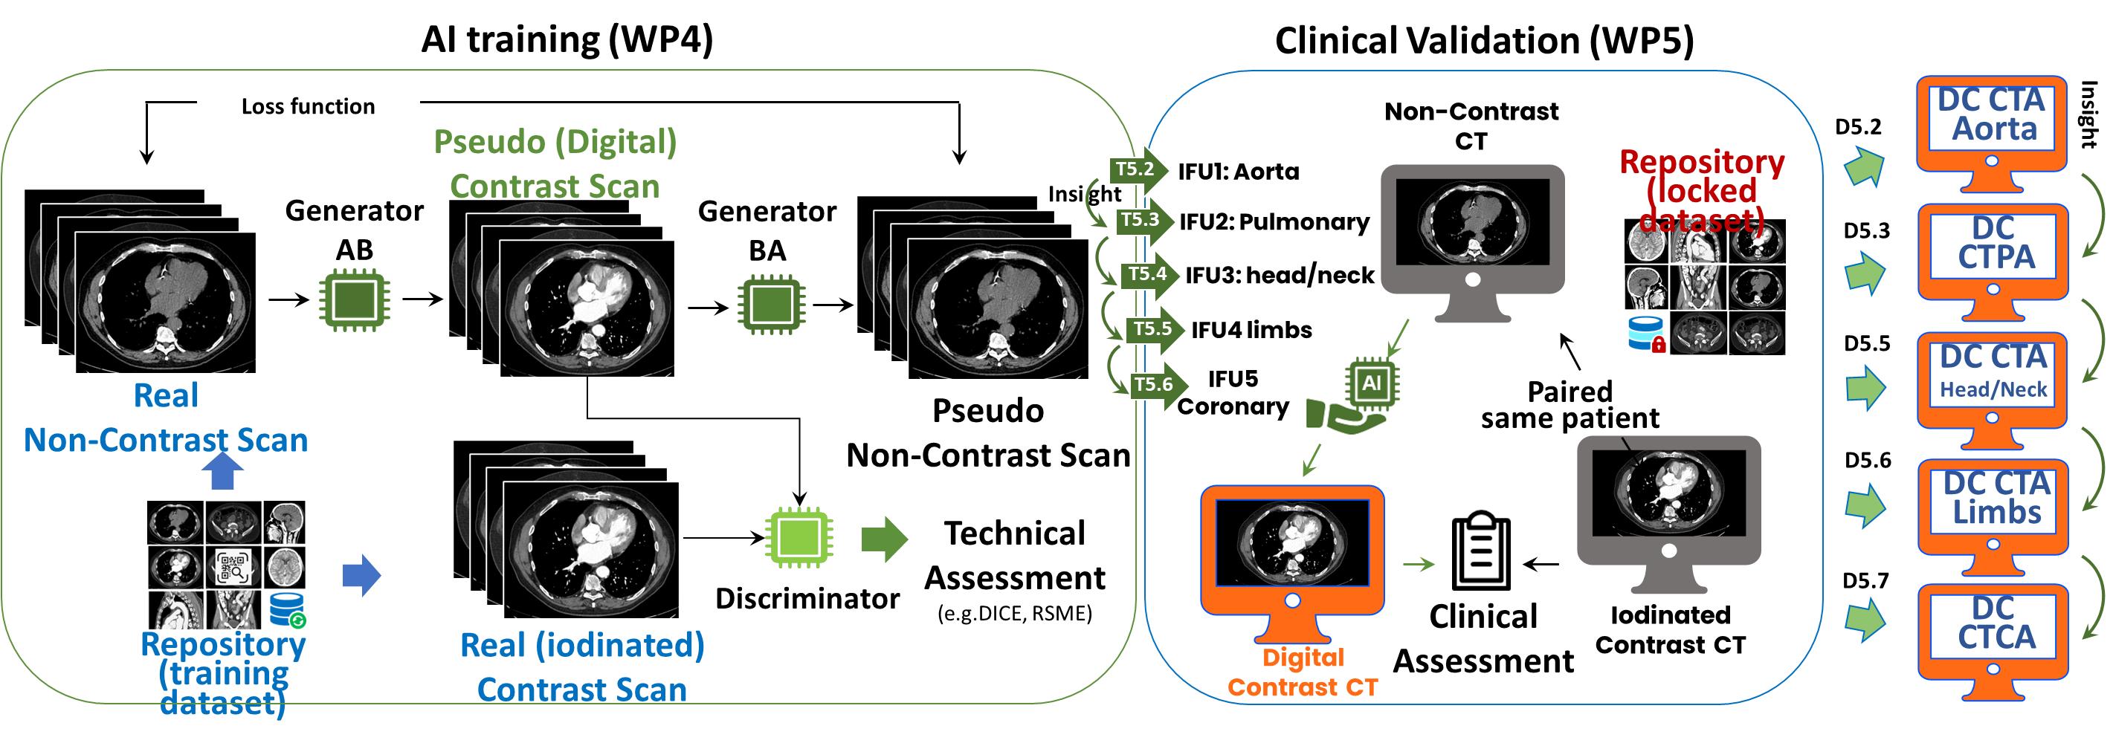
Train and validate CT angiogram applications
IFU = Indication for use
NetZeroAICT

Slide 22
NetZeroAICT Consortium

Slide 23
